Slide 1
Recruiting
Supervising Coordinator : Stephanie Ng

Slide 2
What is Recruiting?
Is to identify candidate and pursue candidate that is looking for what we do or what we can provide them.

Slide 3
Concept of Leverage
“I would rather have 1% of the effort of 100 men than 100% of my own effort.”
- J Paul Getty

Slide 4
Purpose of Recruiting
Expand Distribution
Add leaders to manage the team
Build Continuation process of the business and Duplicate it
Increase Leverage

Slide 5
Becoming a Master Recruter
Mindset
Candidate List
Call Workshop
Tools
GMTSS Calender and Tickets
Overcoming Objections
Understanding Residual Income
Selling Tickets

Slide 6
Recruiting Mindset
It an process not an event
It is a numbers game
Consistency is the Key
Learn by Doing A lot
Learn from many failure
Fail faster
Leverage and learn
How you approach your database

Slide 7
Brain Storming
60-200 names
Friends, family, neighbors, teammates
High school and college classmates
Organizations, Churches, or groups that you belong to or have belonged to
Work colleagues (current and past positions)
Building A Names List
Social media

Slide 8
Categorizing
Product (P), Business (BIZ)
Wellness (PW), Weight Lost (PT) Beauty (PB), Shopping (PS)
Customize approach individually
Keep updating Database weekly and daily
Speed on building this business is in the Database(AKA Names list)

Slide 9
Mobile App

Slide 10
Call WorkShop

Slide 11
WHY DO CALL WORKSHOPS WORK?
It is scheduled
Power of positive energy of two or more people
Coaching
Starts a new person fast
Accountability
Continues momentum in the business

Slide 12
Preparation
20 names and phone numbers
In a home, coffee shop, wherever
Fully charged cell phone (bring chargers)
Schedule options, know what you can book into – 2 on 1, HBP, UBP, Webinar

Slide 13
The Calls
Start with the most experienced team member making calls
Each team member MUST make calls

Slide 14
Call Workshops are a Great Way to Book Appointments Hit key points
I only have a second,
the reason I’m calling is _____
I want to get together for coffee (Could be with or without your business partner)
1
4
Edify (you may know the right people)
You may or many not be interested, either way is fine with me
2
5
Can you help me out?
3

Slide 15
Setting an Appointment

Slide 16
Is there any reason between now and then that you would change the appointment?
There are 2 kinds of person in the world, those that are honorable and those that are not, which are you?
I am sure you are an honorable one.
Firming up the Appointment

Slide 17
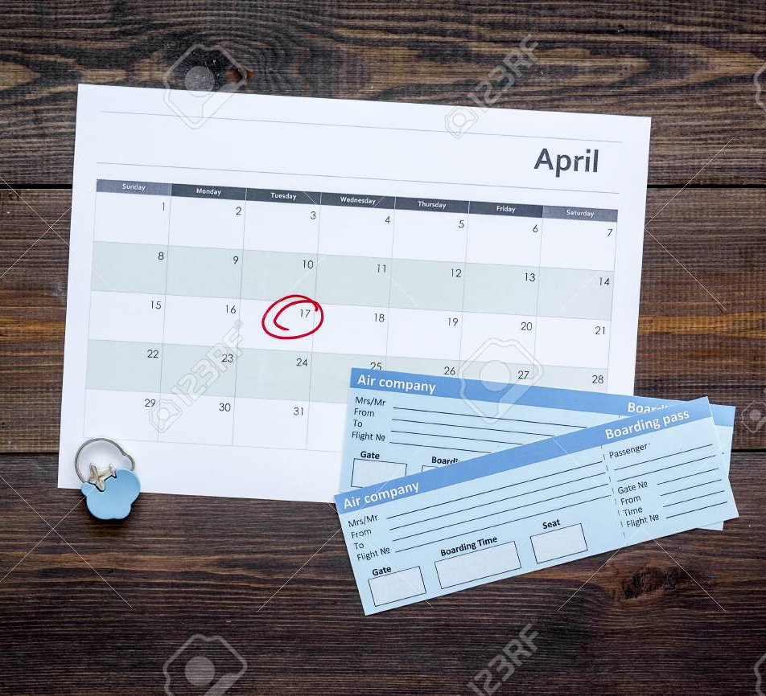
Event Tickets and Calendar
GMTSS EVENT
UBP
Local
GPT
Conference
Home Events
HBP
Product Events
Networking Events

Slide 18
USE Professional Language NOT MA LANGUAGE

Slide 19
Don’t say this
Instead say this
I JOINED Market America
I started my own business
I’m a member of Market America
I own a business
I do Market America
I work for myself
There’s a UBP meeting Tuesday night
There is a business presentation Tuesday night

Slide 20
Don’t say this
Instead say this
I hit 1200 and 1200 and got my first check
I earned my first commission
My business partner’s name is Dan
My sponsor’s name is Dan
I want you to meet the people in my upline
I want you to meet my business partners
I already have people below me
My business is already growing

Slide 21
Don’t say this
Instead say this
The person I am working with is a National Supervising Coordinator
The person I am working with has exceeded $10,000 in a month in commissions
When do you want to sign-up/get in?
When would you like to start/register your business?
Check out my SHOP.COM portal
Check out my SHOP.COM SITE

Slide 22
Overcoming Objections

Slide 23
Tips Handling Objections
Do not be Defensive
Do not be Offensive
Ask question when you do not understand
Allow the Candidate to self discover
Peel the “Onion” Deeper
There are times you may have to walk away or even stand your position.

Slide 24
LEARN HOW TO SHOW THE PLAN

Slide 25
Ways to show the Plan
UnFranchise Business Presentation (PPT)
23 minute video (YouTube)
Flip Chart (code 700)
Tools available
Power Profiles
UnFranchise® Owner Magazine
Global Annual Report
About MA (download)
Websites (SHOP.COM, MotivesCosmetics.com, MarketAmerica.com, etc.)
Product Catalogs
Home Shopping List / Shopping Annuity® Assessment
Sharing the
UnFranchise Business

Slide 26
BEFORE THE PLAN
Ask questions and learn about them
FORM (Family, Occupation, Recreation, Money) Expose their pain
People will be attracted when you show that you care,
you are excited, and you believe in your business
People buy you

Slide 27
DURING THE PLAN
Let them know that you and your team will support them
(in business for themselves but not by themselves)
Explain how the system will help them
Let them know that some people will be skeptical or negative (crucial)
Be prepared to ask if they are interested in getting started or learning more

Slide 28
Scheduling the follow up appointment
It is a successful meeting if a
follow up is
booked
Have your schedule available and book the next step
Schedule a follow up meeting to answer questions or get started
You have to continue to follow up until they get started or let you know they are not interested
Sense of urgency is crucial, book the follow up within 48 to 72 hours if possible

Slide 29
Scheduling the
follow-up appointment
If it is to answer questions
If it is to get them started
Answer questions
Sell tickets
Get them to lead to their people
Book registration date
Sell product
Help qualify top ten possibilities
Sell tickets

Slide 30
Confirm the next appointment
Send them a webinar link
Send them About MA document
Send them videos (YouTube, UnFranchise.MeetOn, Power Profiles)
WHAT TO DO BETWEEN APPOINTMENTS
Schedule a three way call

Slide 31
Recruiting
Supervising Coordinator : Stephanie Ng

